Slide 1
Intro to Design Patterns
Lecture 5.1 – Bridge Pattern

Slide 2
Reading
DPE
Chapter 10 – The Bridge Pattern

Slide 3
If the Abstractions and Implementations are varying use the Bridge pattern
Technique
Abstract both the Abstractions and the Implementations.
Two inheritance hierarchies
Abstraction
Implementation
Benefits
Decouples the implementations from the abstractions.
Avoids combinatorial explosions.
Follows open/closed principle.

Slide 4
Consider Different Thread Schedulers Implementation Will be Platform Dependent
Initially
Two kinds of thread schedulers:
Pre-emptive
Round robin
Two kinds of platforms:
Unix
Windows
Later
More kinds of thread schedulers:
Time sliced, prioritized
More kinds of platforms:
OS10, iOS, JVM

Slide 5
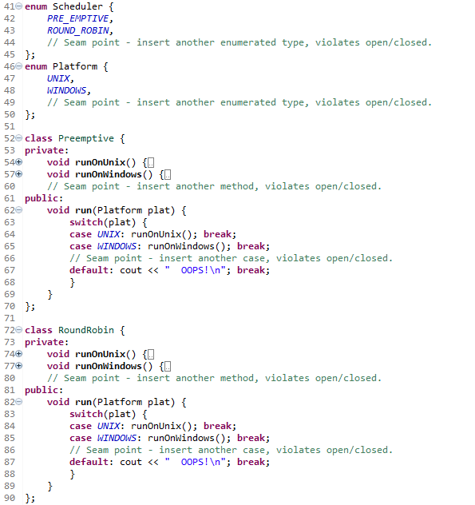
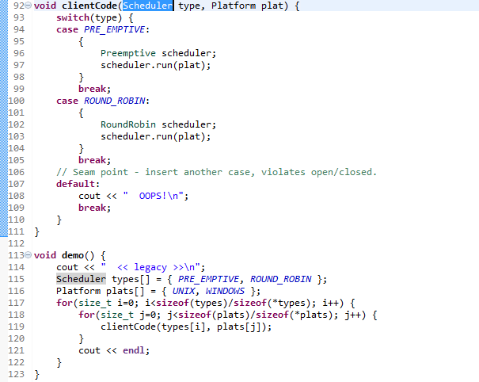
Legacy Example

Slide 6
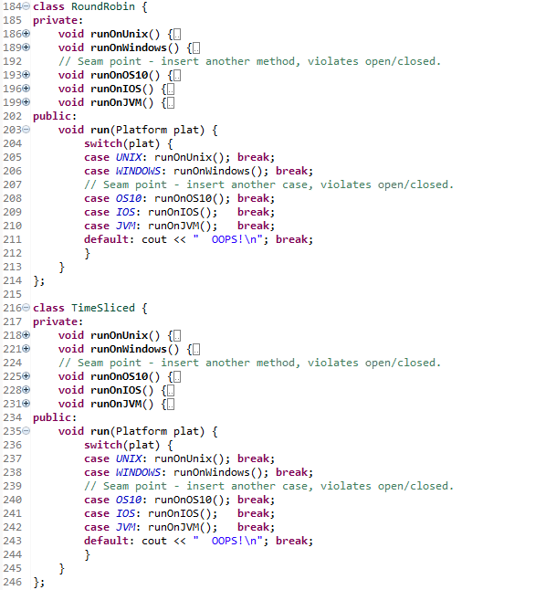
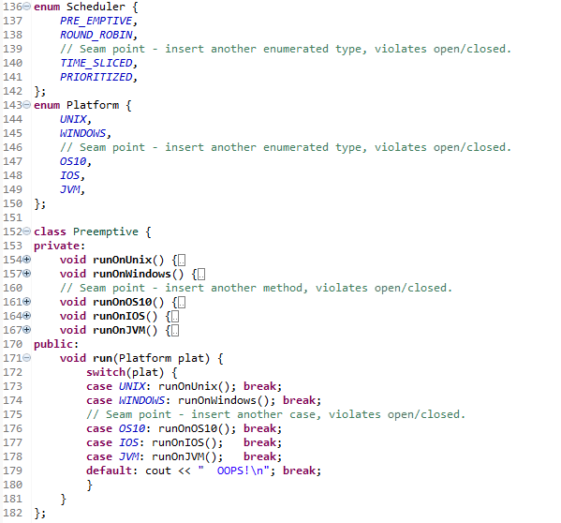
Problem Example

Slide 7
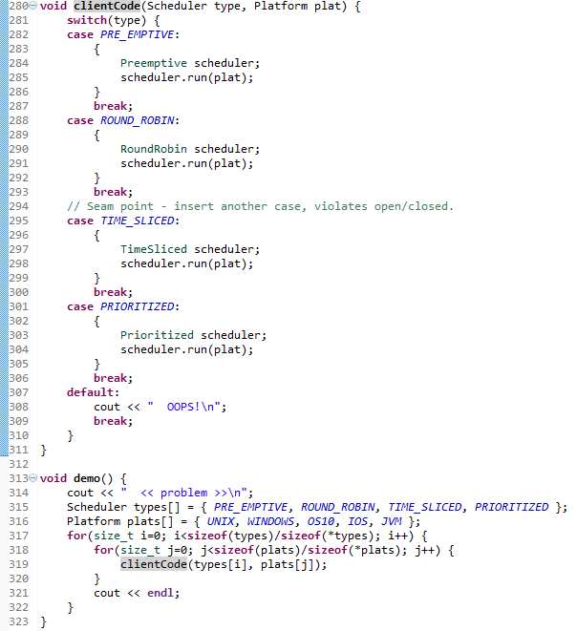
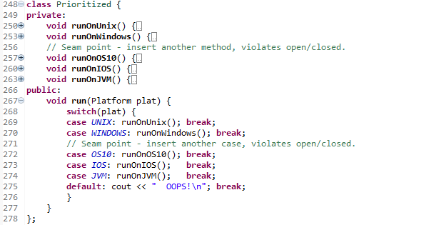
Problem Example Cont.

Slide 8
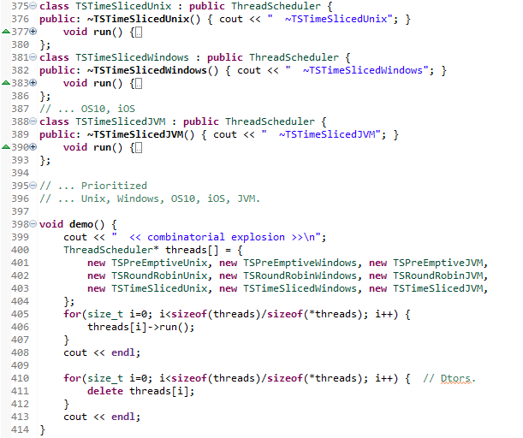
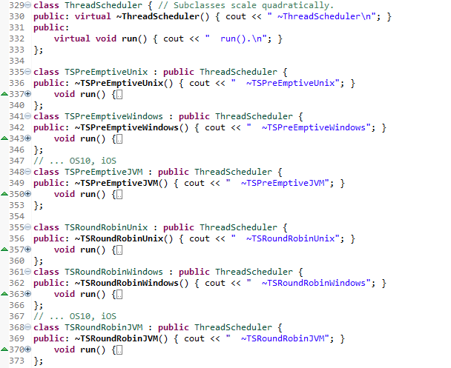
OOP helps, clean client code, no seam points, but still have Combinatorial Explosion

Slide 9
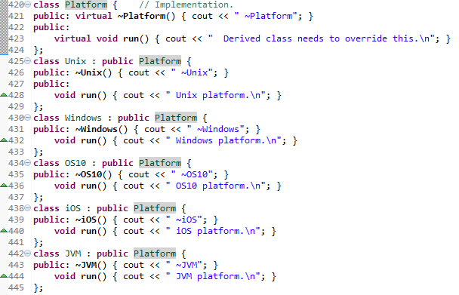

Solution Example

Slide 10
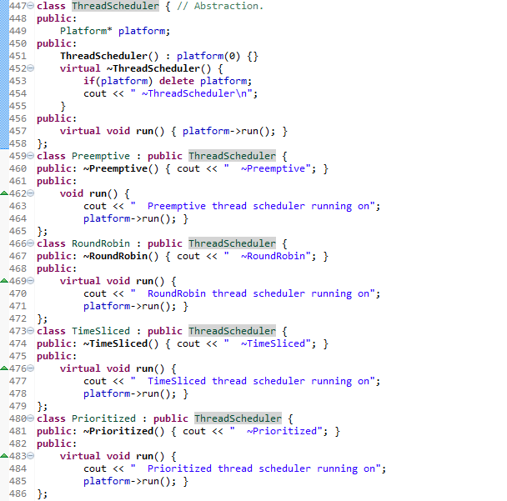
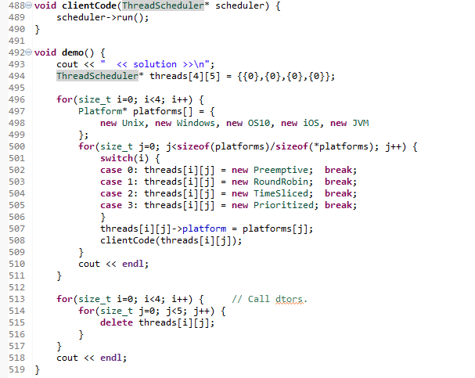
Solution Example Cont

Slide 11
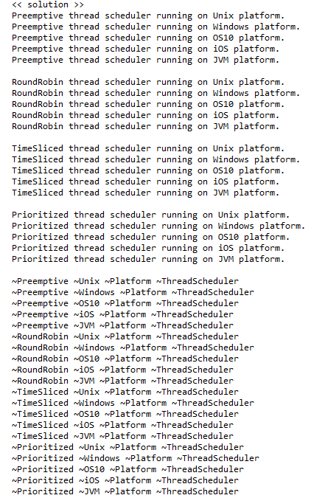
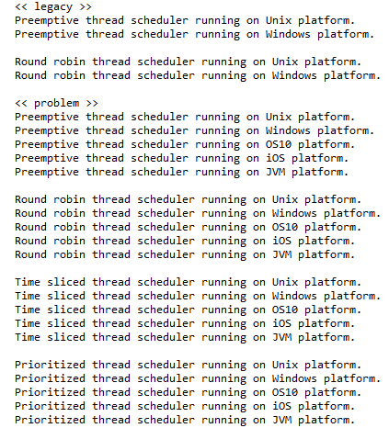
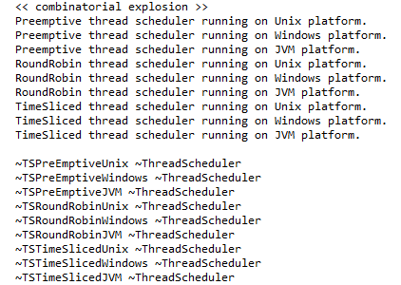
Output
Notes:
Note how the dtor unwinds the objects.

Slide 12
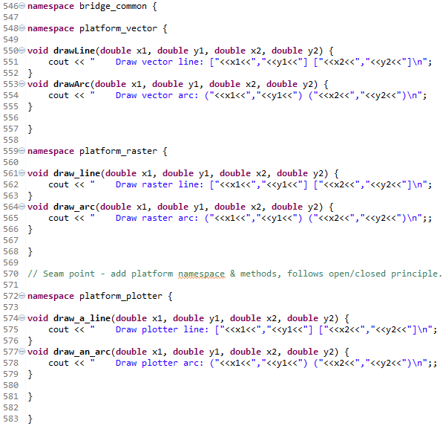
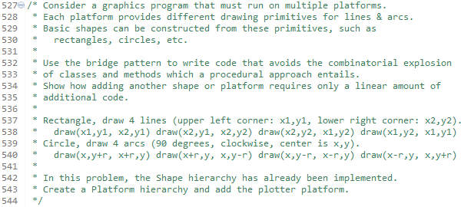
Homework

Slide 13
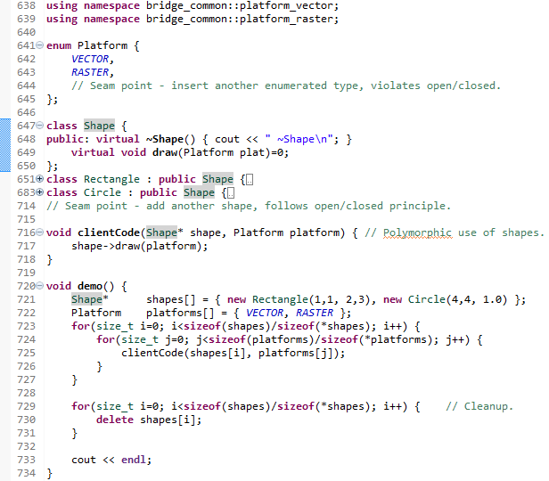
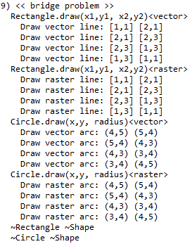
Problem

Slide 14
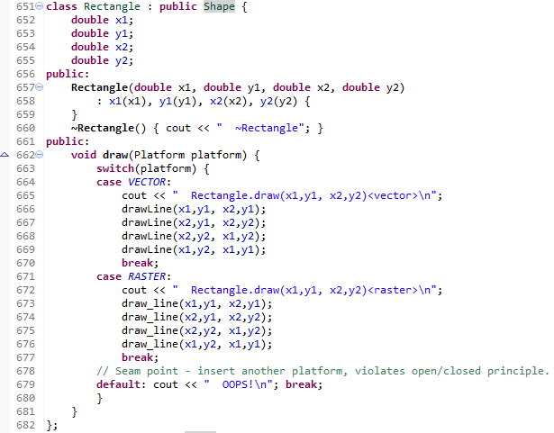
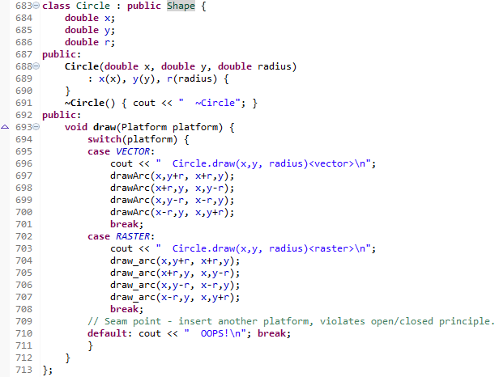
Problem Cont.

Slide 15
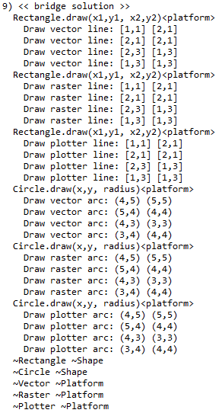
Solution Sample Output

Slide 16
Summary
When the abstractions must varying independently of the implementations, use the Bridge pattern to encapsulate both sets of variations.
There will therefore be two inheritance hierarchies;
The Abstractions
The Implementations
Follows the open/closed principle.
Because there are two things varying, this often also avoids a combinatorial explosion of code.

Slide 17
Class Progress
If the algorithms are varying
If the interfaces are varying
If the API’s are varying
If the steps are varying
If the classes are varying
If the options are varying
If the listeners are varying
If the responders are varying
If abstract’n & implement’n vary
If the families are varying
Use the Strategy pattern
Use the Adapter pattern
Use the Facade pattern
Use the Template Method pattern
Use the Factory Method pattern
Use the Decorator pattern
Use the Observer pattern
Use Chain of Responsibility pattern
Use the Bridge pattern
Use the Abstract Factory pattern

Slide 18
Backup Slides

Slide 19
